Slide 1


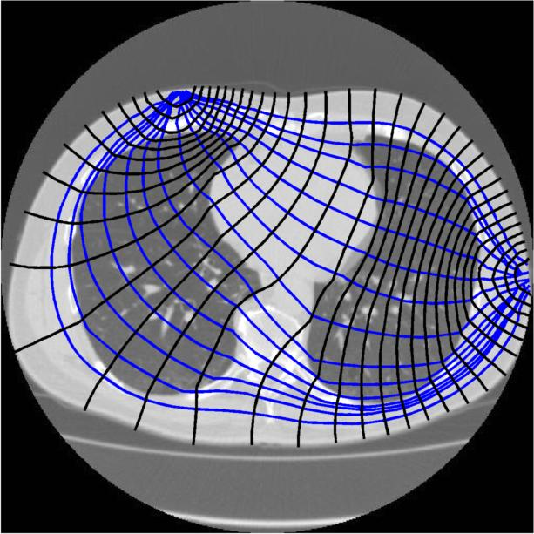
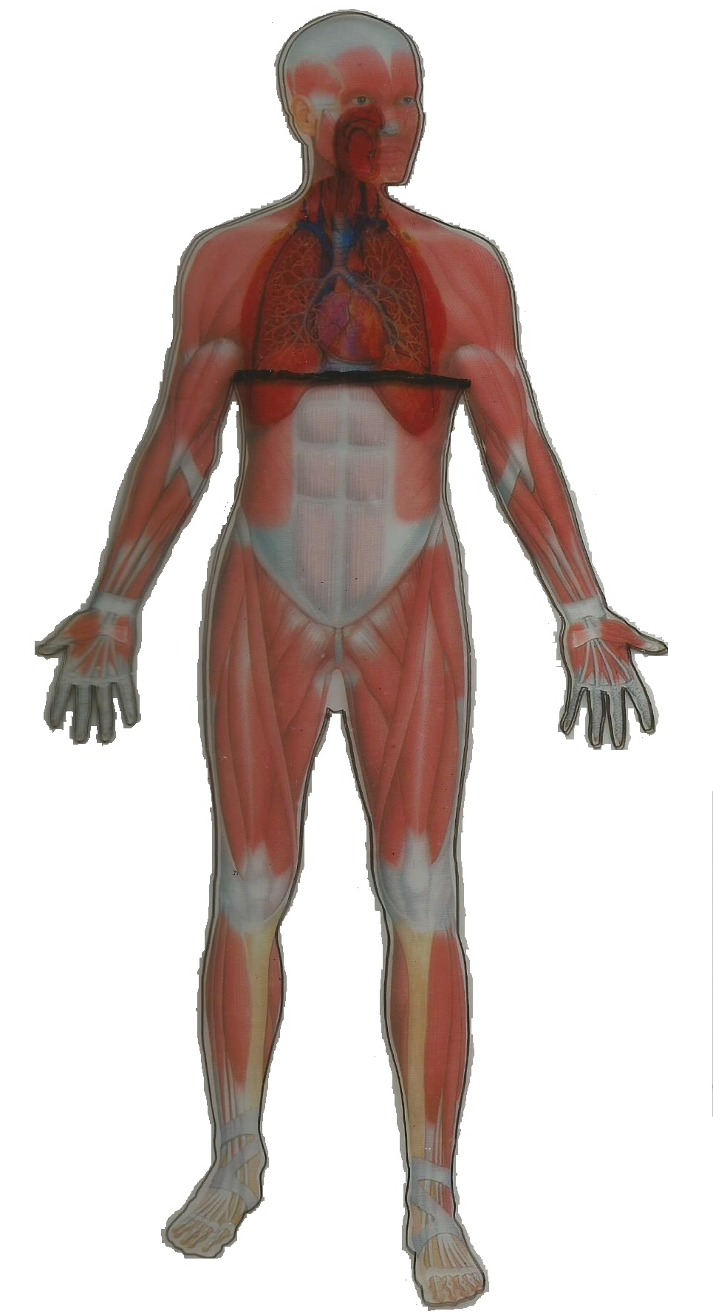
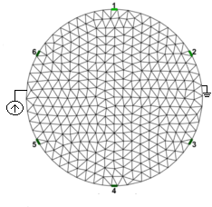
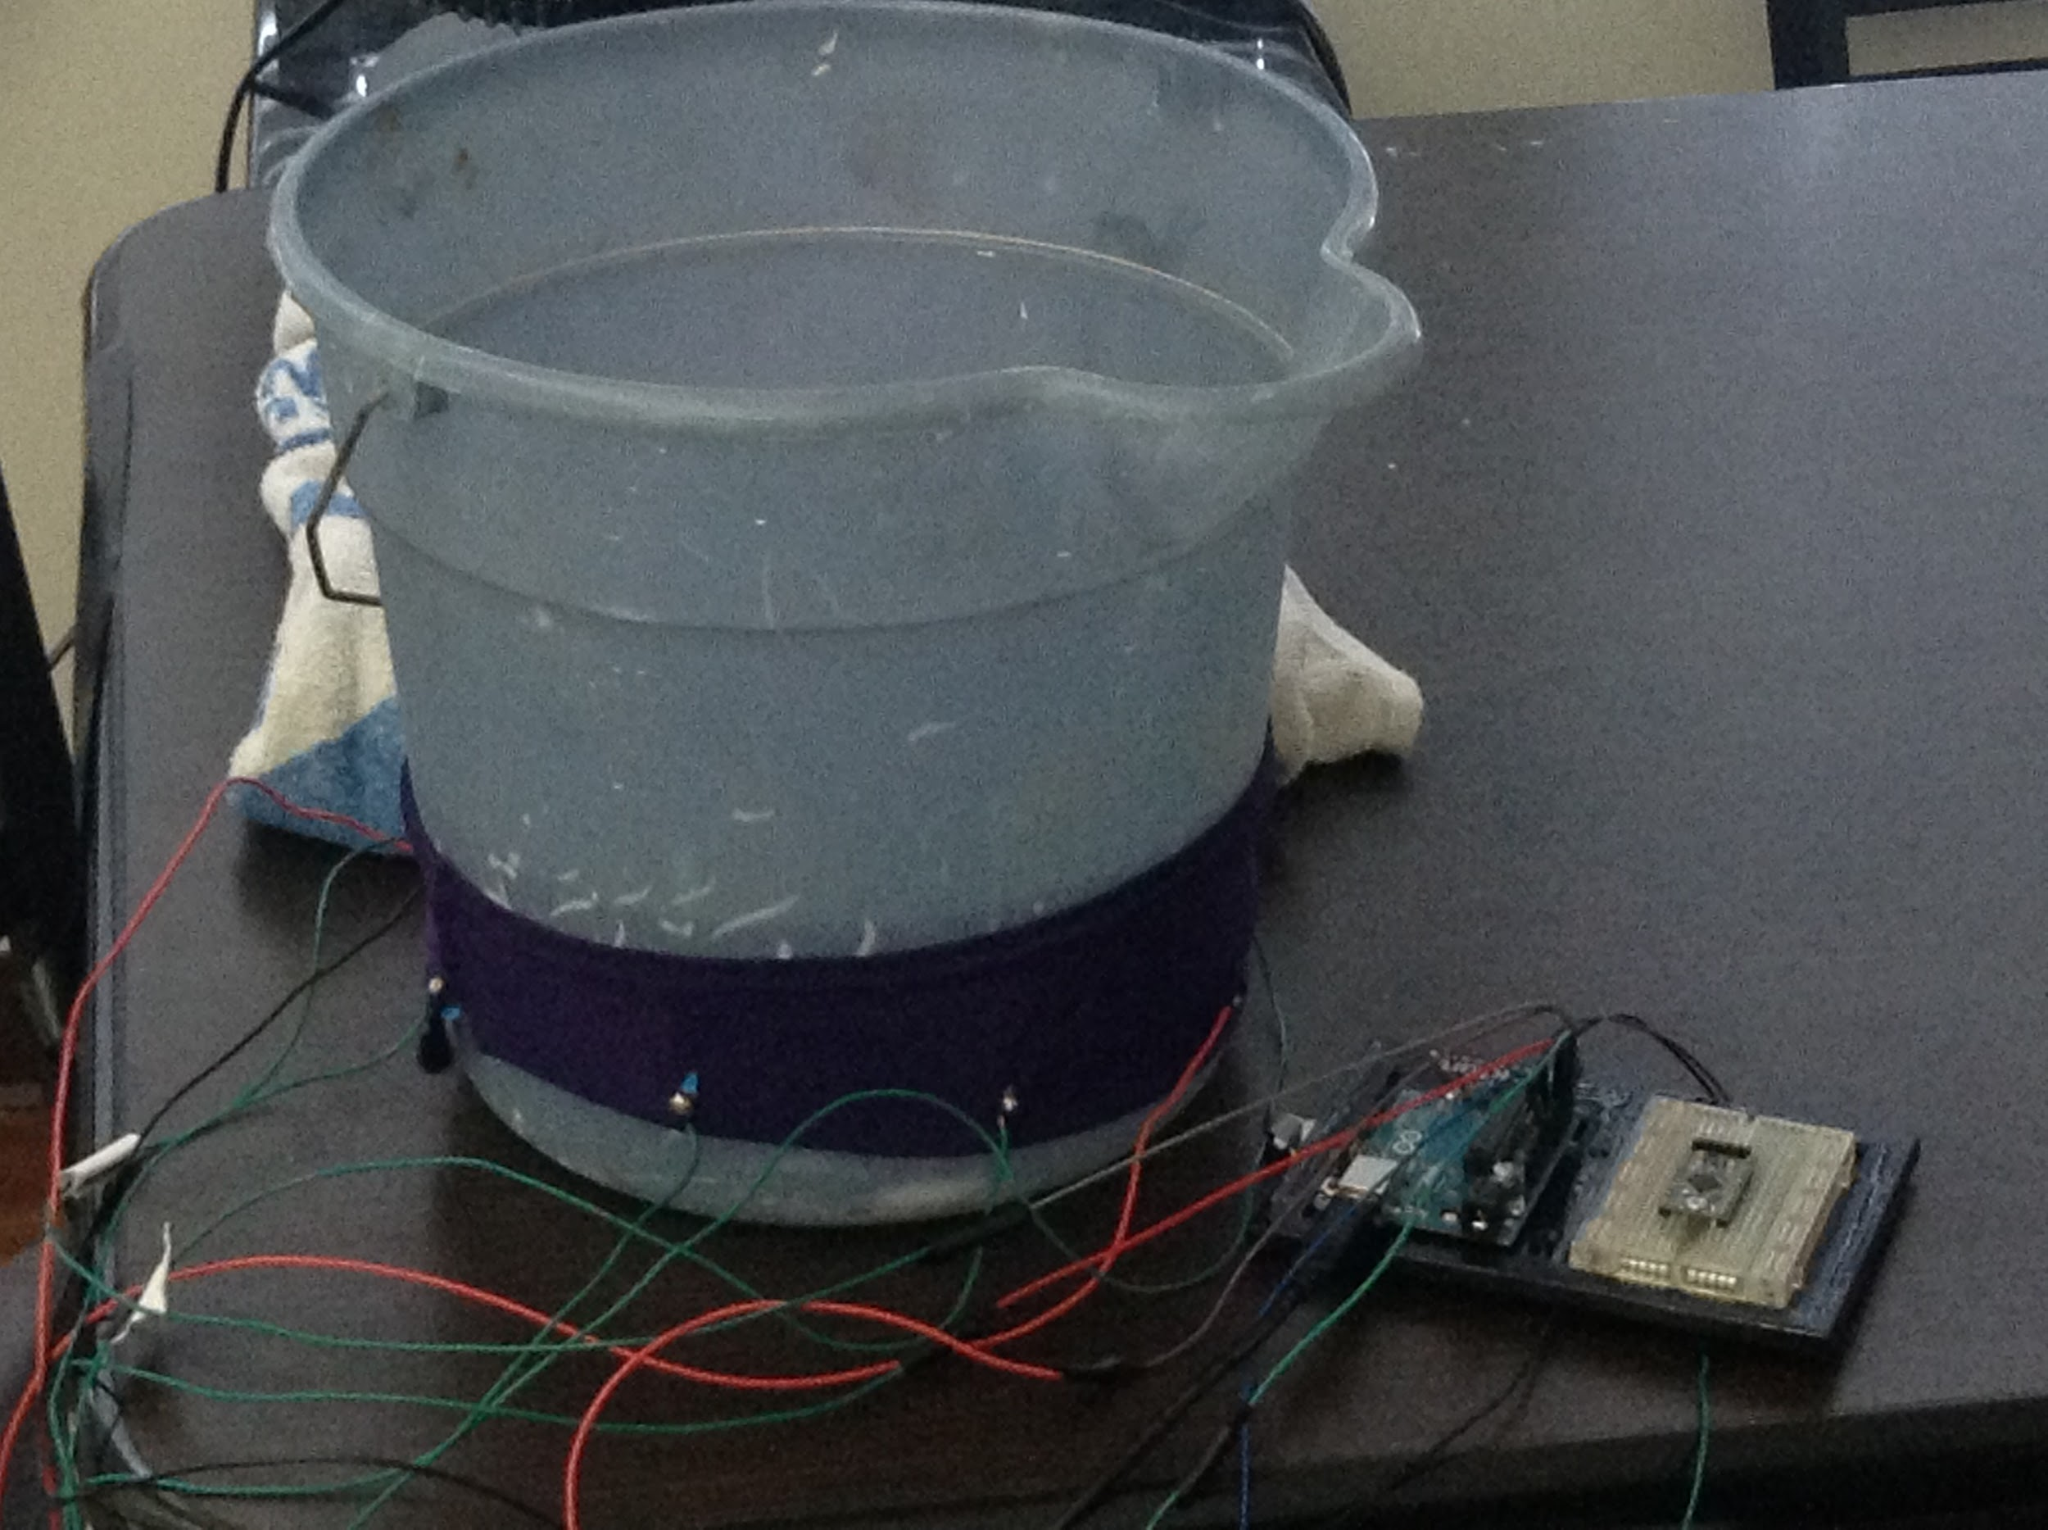
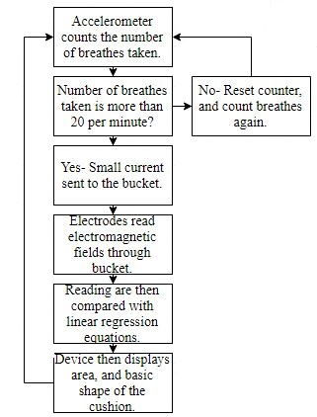
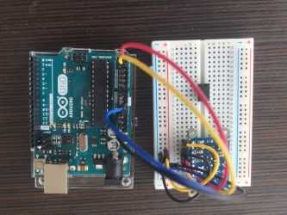
Mobile Respiratory Monitor
Desmond Davis, Larry Huang, Benjamin Kessler
Advisors: Prof. Joseph Santacroce, Dr.Julius Marpaung, Dr. Douglas Dow
Department of Electrical Engineering and Technology (BSEE)
Wentworth Institute of Technology
Need and Problem
Respiration difficulties lower the quality of life for many people
Medical images of lungs are key to diagnosis and monitoring of changes during therapy
Alternative methods for clinical imaging:
X-Ray, MRI, Clinical EIT
Imaging in a clinic has disadvantages:
Cost, travel, time
Many people behave differently in a clinic than at home, so physician may miss episode of respiratory problem
Imaging of lungs during respiration is more useful if done in a natural setting, and when difficulty breathing is occurring
Proposed Solution:
The Mobile Respiratory Monitor uses Electrical Impedance Tomography (EIT) to create an image of the patient's lungs.
Breath rate is monitored using an accelerometer, which triggers the EIT electrode system to image the lungs when breath rate is erratic.
The objective of this project is to develop and test EIT modules to evaluate feasibility of home based EIT imaging.
Figure 1: The diagram of the muscular and respiratory system are shown on the person above. The pink line indicates where the electrodes are placed on the person’s chest.
Figure 2: The current enters the circuit on one side providing power to each electrode before exiting on the other side.
Figure 5: Testing the electrode array on a water bucket and balloon system to simulate the chest cavity.
Conclusions
This technology may be used by physicians to obtain images of the patient’s lungs in a comfortable home environment when respiration becomes abnormal.This technology will reduce time and cost for the patients as well as physicians by reducing the need for frequent check-ups and lengthy, in-hospital testing. Future development and testing is required to send the data wirelessly to physicians.
Methods
The device uses an accelerometer to count an individual's breathing rhythm. If the patient’s breathing rate deviates drastically from the norm, an array of electrodes embedded in a band send small electrical signals into the patient’s torso and use the differences in impedance to create a virtual image of the lung tissue.
References
Electrical Impedance Tomography by Robert W. Stacey
Digital biomedical electrical impedance tomography based on FPGA by Jiani Wu, Xiaoyan Chen, Zhonglin Ding
Monitoring Ventilation Distribution from the Institute of Technical Medicine
Figure 3: The Arduino and accelerometer used to monitor breath rate.
Figure 4: This is a flowchart of the steps the device takes in order to complete its desired function.

